Slide 1


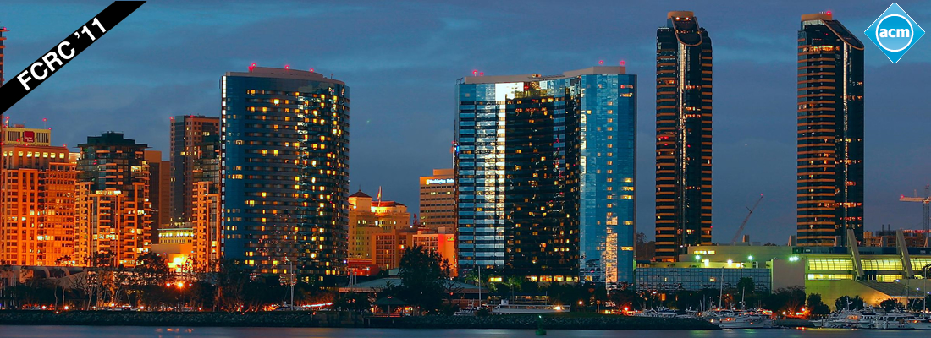
Welcome to
ACM SIGPLAN
X10 Workshop
San Jose, CA

Slide 2
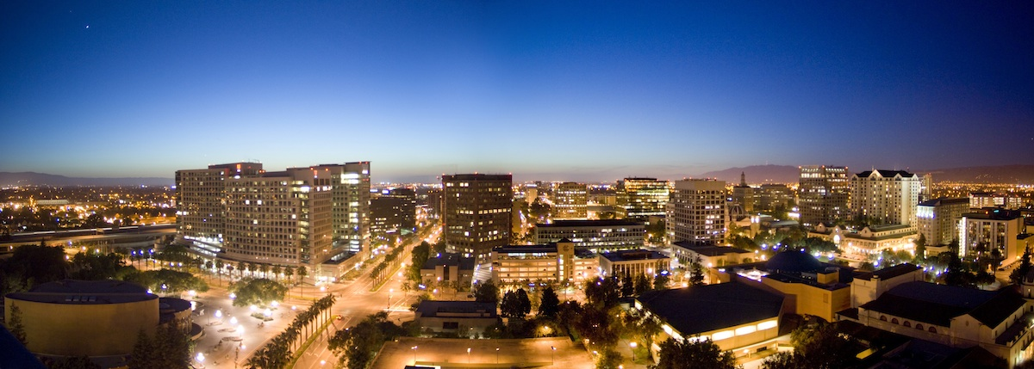
Welcome to
ACM SIGPLAN
X10 Workshop
San Jose, CA

Slide 3
Welcome
Goals of the workshop
Bring together X10 educators, application writers, and language/tooling implementers
Help to foster collaboration among the growing X10 community
Use today’s momentum to enhance the X10 virtual community

Slide 4
Thanks!
Program/Organizing Committee
  Steve Blackburn
  Doug Lea
  Michael Hind, GC
  Kathryn McKinley
  Jens Palsberg, co-PC Chair
  Vivek Sarkar
  Vijay Saraswat, co-PC chair
Speakers
Attendees

Slide 5
Logistics
Please the complete workshop feedback form
  X10 t-shirts to those who complete the form
Most papers are available at
  http://x10.svn.sourceforge.net/viewvc/x10/external/X10 Workshop (2011)/papers/
  Will be links from workshop program page soon
    X10-lang.org/workshop/program
Speakers: send me (hindm@us.ibm.com) your slides
  Will post on workshop page
Would like to video the presentations for web posting – need help!
  Speakers: lease sign release form, if possible
Post workshop X10 “hack-a-thon”?

Slide 6
Program
8:30 Welcome - Michael Hind
8:40 X10 in a Nutshell by Vijay Saraswat
9:10 Session I, Chair: Steve Blackburn
A Performance Model for X10 Applications by David Grove, Olivier Tardieu, David Cunningham, Ben Herta, Igor Peshansky and Vijay Saraswat
Parallel Programming: Design of an Overview Class by Christoph von Praun
10:10 Break
10:40 Session II, Chair: Jens Palsberg
Object Initialization in X10 by Yoav Zibin, David Cunningham, Igor Peshansky, and Vijay Saraswat
Compiling X10 to Java by Mikio Takeuchi, Yuki Makino, Kiyokuni Kawachiya, Hiroshi Horii, Toyotaro Suzumura, Toshio Suganuma, and Tamiya Onodera
Work-Stealing by Stealing States from Live Stack Frames of a Running Application by Vivek Kumar, Daniel Frampton, David Grove, Olivier Tardieu, and Steve Blackburn
12:10 Lunch
1:30 Session III, Chair: Vivek Sarkar
Using the Cowichan Problems to Investigate the Programmability of X10 Programming System by Jeeva Paudel and Jose Nelson Amaral
X10 implementation of Parallel Option Pricing with BSDE method by Hui LIU, Ying Peng, DaiZhen Wei and Bin Dai
Distributed deductive databases, declaratively: The L10 logic programming language by Robert Simmons, Frank Pfenning, and Bernardo Toninho
3:00 Break
3:30 Session IV, Chair: Doug Lea
X10 on the Single-Chip Cloud Computer by Keith Chapman, Ahmed Hussein, and Antony L. Hosking
GPU Programming in a High Level Language Compiling X10 to CUDA by David Cunningham, Rajesh Bordawekar, and Vijay Saraswat
Phaser Beams: Integrating Stream Parallelism with Task Parallelism by Jun Shirako, David Peixotto, Dragos Sbirlea and Vivek Sarkar
5:00 X10 Roadmap and user community discussion - Michael Hind and Vijay Saraswat
5:30 Workshop Concludes

